Slide 1

On Solving MIS with Rydberg Atom Array
G. Heller, P. Mathur, J. McCarran, K. Pingle, & P. Putalapattu

Slide 2
Problem Introduction

Slide 3
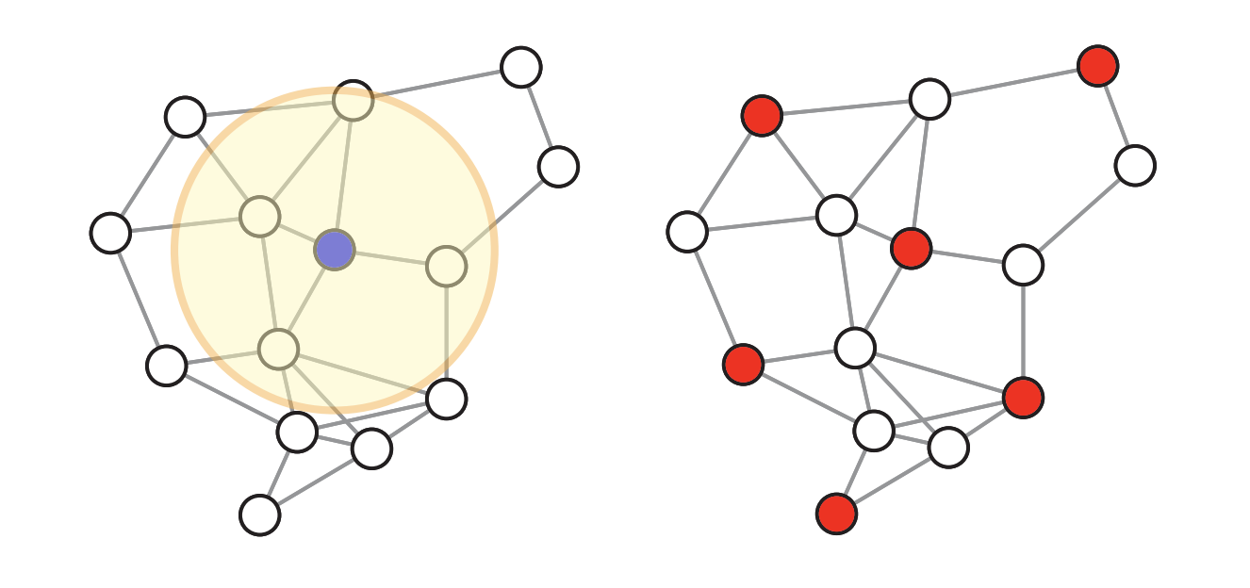
The Maximum Independent Set Problem (MIS)
Unit-Disk Graph
MIS Solution
Notes:
Discuss what it means to define a graph using unit disks
Explain solution to the MIS problem

Slide 4
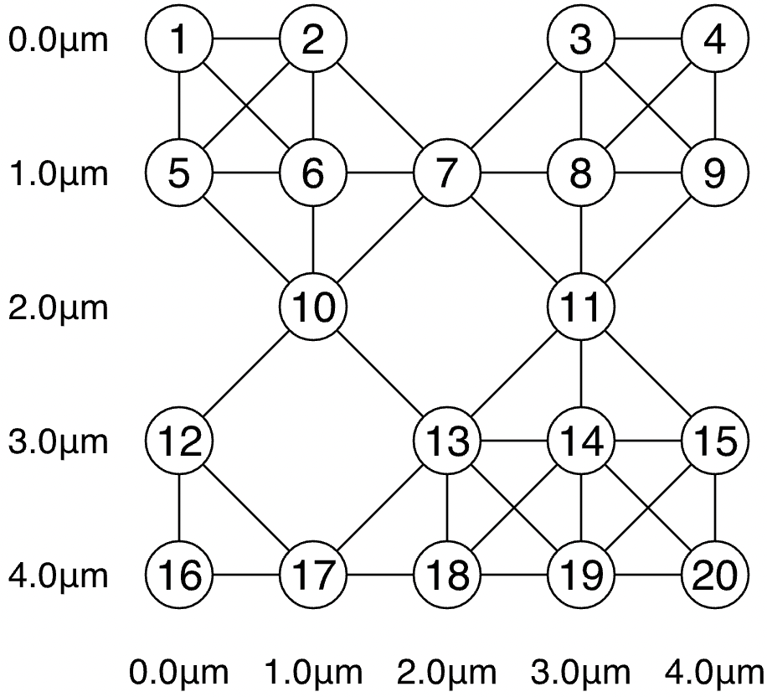
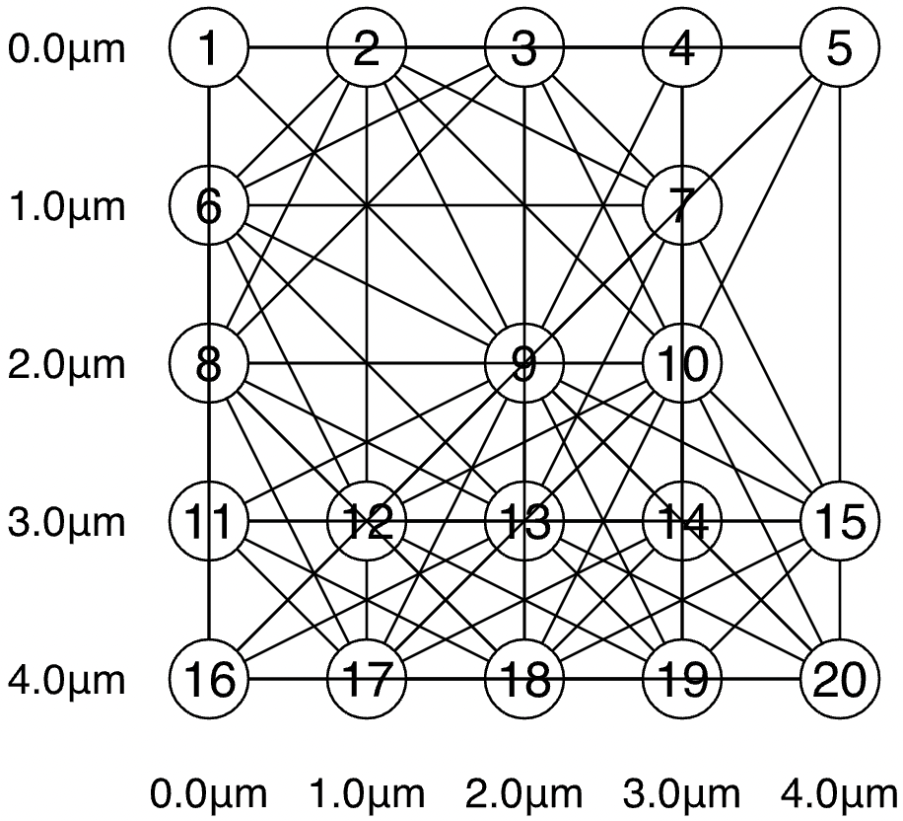
Beyond the King’s Graph
?
Adjacent and Diagonal Connections
Three Lattice Constant Radius
Notes:
On a square lattice
20% of nodes are dropped out

Slide 5
Theory

Slide 6
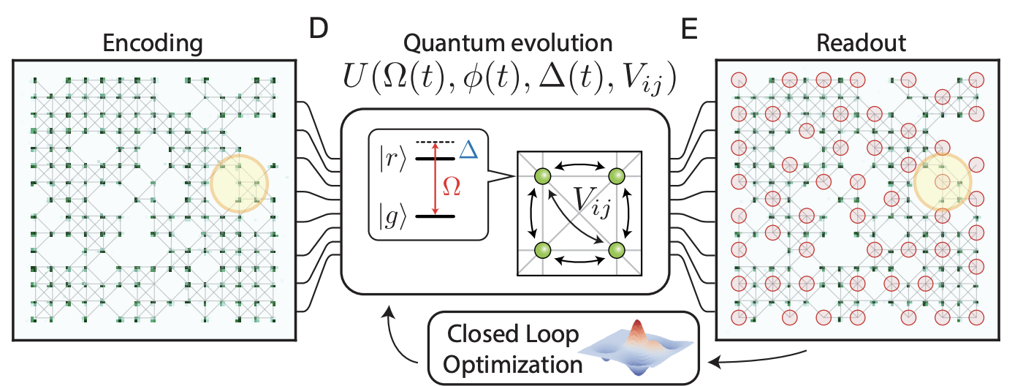
Set-up
Ebadi et. al.: grid of Rydberg atoms as in QuEra to simulate interactions
Fig. 1 Ebadi et. al.

Slide 7
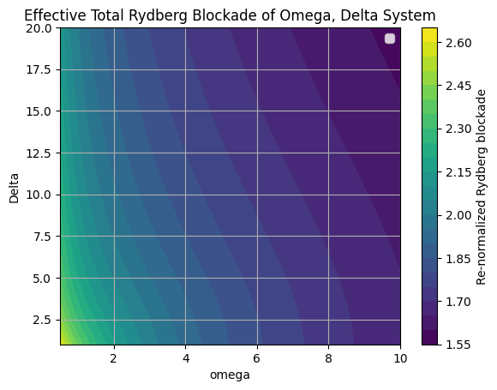

Effective Rydberg Radius Function of Detuning, Rabi freq.
From first principles:
Ebadi, et. al. R_eff = 1.6
Nelder-mead
Our study, R_eff = 2.1
Notes:
Using generic tensor networks, Bloqade, or your favorite method to estimate the (quantum and classical) annealing hardness parameters of the problem instances you found

Slide 8
What range is feasible on a quantum computer?
For a small Rabi Frequency, small mixing times and decoherence times will drastically impact our qubits as we scale the problem
Given our effective Rydberg Blockade averaged estimate, we need a really small Rabi to reach r=3. Thus we claim this is likely unfeasible as our lattice scales beyond n=10 for current hardware limitations
However, r=(20^0.25)>2 is in the feasible range (Rabi ~ 2MHz, Detuning ~5 MHz), so we expect r=2 is possible as we scale to a 15x15 lattice.

Slide 9
Further optimizations
Discussed a method based on individual addressing (existing technology as in Mennssen et. al.) to choose a smart initial state
Choose initial state with full grid solution, then drop detunings of atoms which we want to drop out of lattice as our adiabatic approach
We expect the time of algorithm to be much smaller, thus errors will scale accordingly
If qubits can be brought within 2.85 um we can then expect to robustly solve r=3 case for n>20.

Slide 10
Programming and Experiments

Slide 11
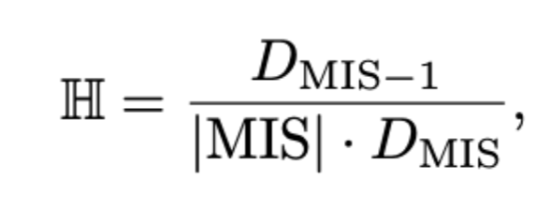
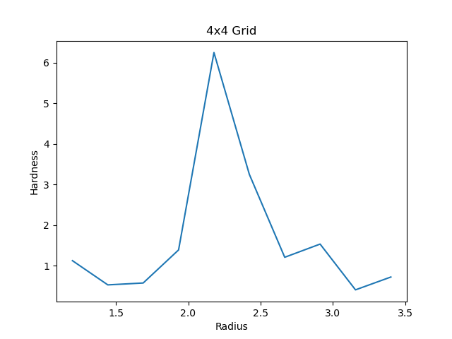
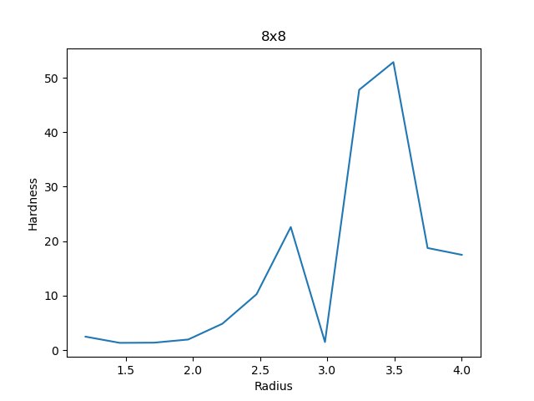
The Hardest Problems (Classically)
Andrist et al. 2023
Notes:
Using generic tensor networks, Bloqade, or your favorite method to estimate the (quantum and classical) annealing hardness parameters of the problem instances you found

Slide 12
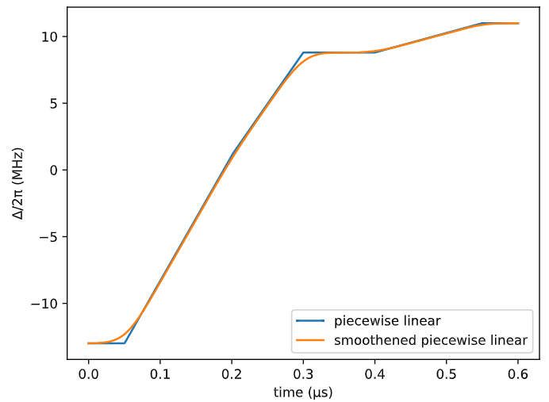
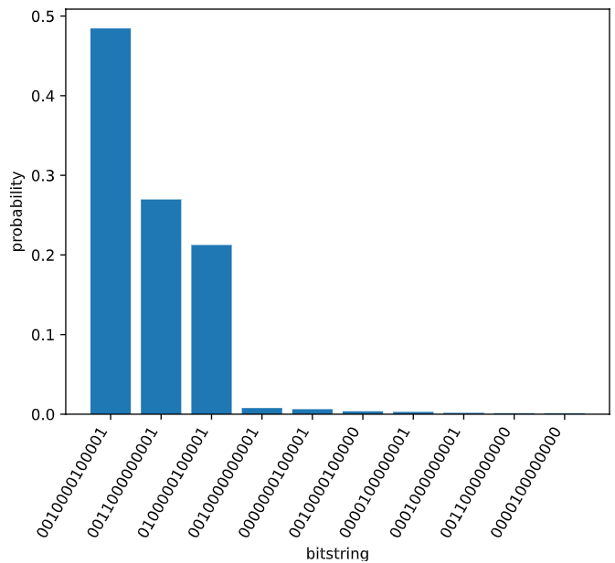
Easy Nelder Mead (4x4, Rb/a = 2.51)
Notes:
sqrt(sqrt(40))

Slide 13
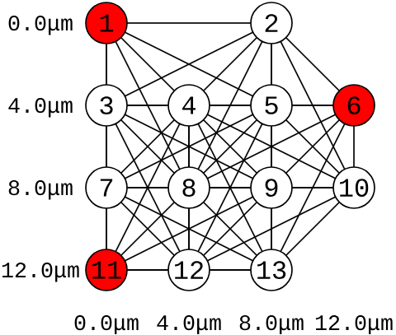
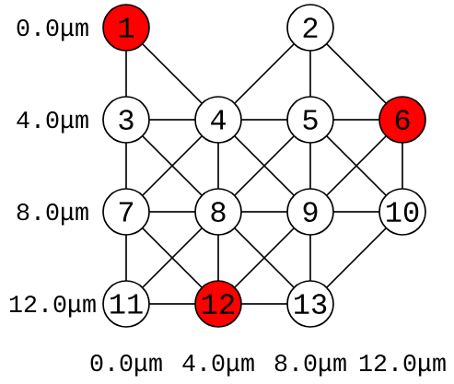
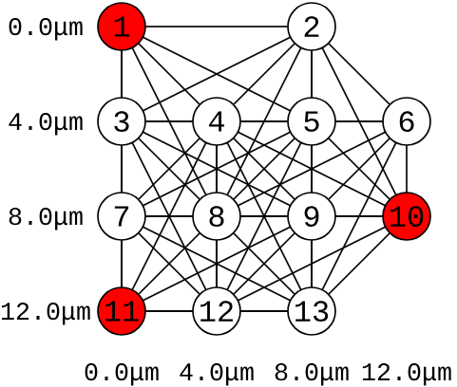

Slide 14
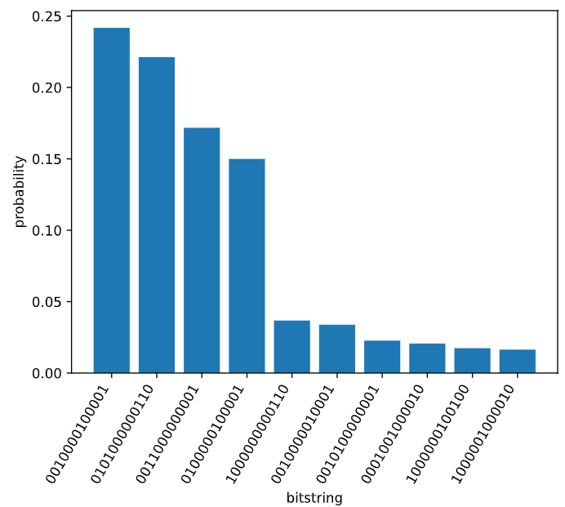
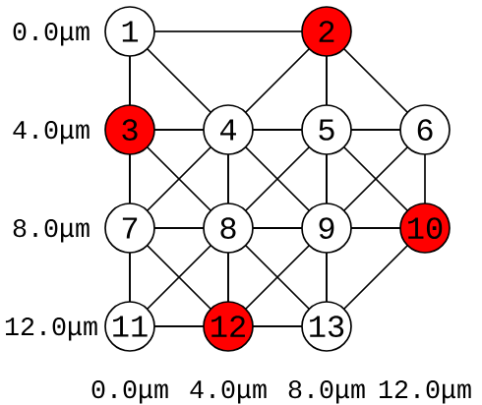
Hard Nelder Mead (4x4, Rb/a = 2.11)
Notes:
sqrt(sqrt(20))
Harder problems classically -> harder problems quantumly

Slide 15
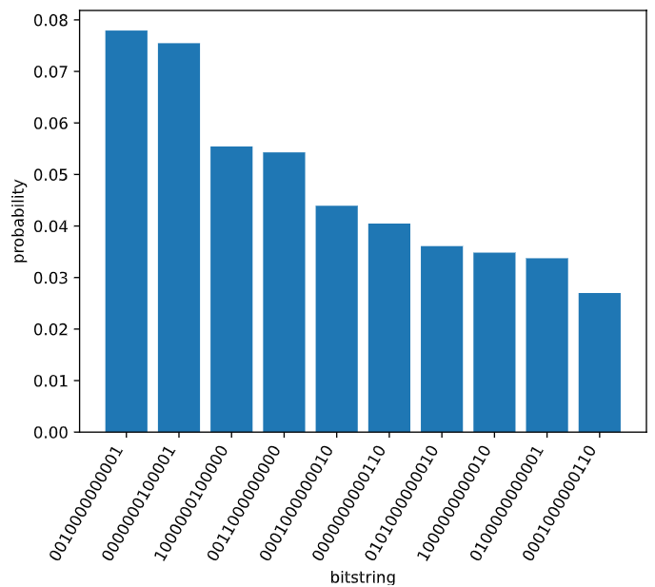
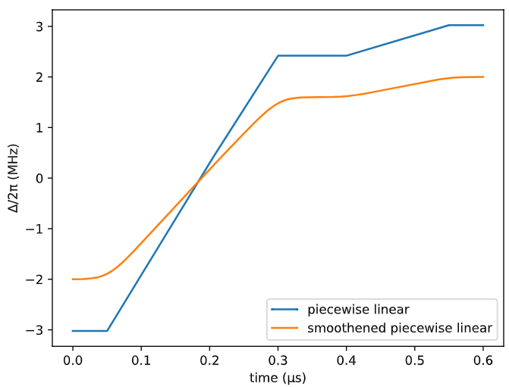
Hard Nelder Mead with Limitations

Slide 16
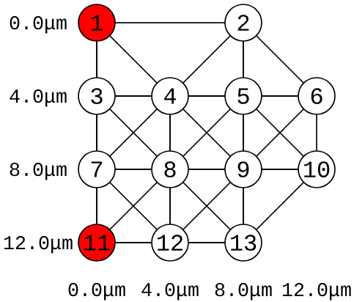

Slide 17
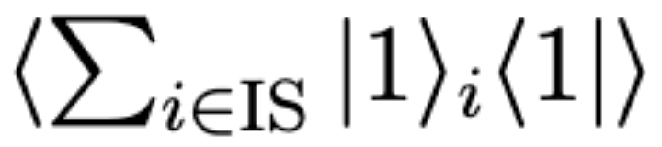
Loss Function: Rydberg Density Sum
=
Weighted average number of Rydberg atoms in eigenstates corresponding to IS configurations.

Slide 18
Grid Search Results
Unrestricted
Searched
Ω from 3*2π to 5*2π
Δ from 10*2π to 15*2π
Optimal Values
Ω = 4*2π
Δ = 11.75*2π
Limited to Aquila Specs
Searched
Ω from 2 MHz to 2.5 MHz
Δ from 0 MHz to 20 MHz
Optimal Values
Ω = 2.5 MHz
Δ = 6.8 MHz

Slide 19
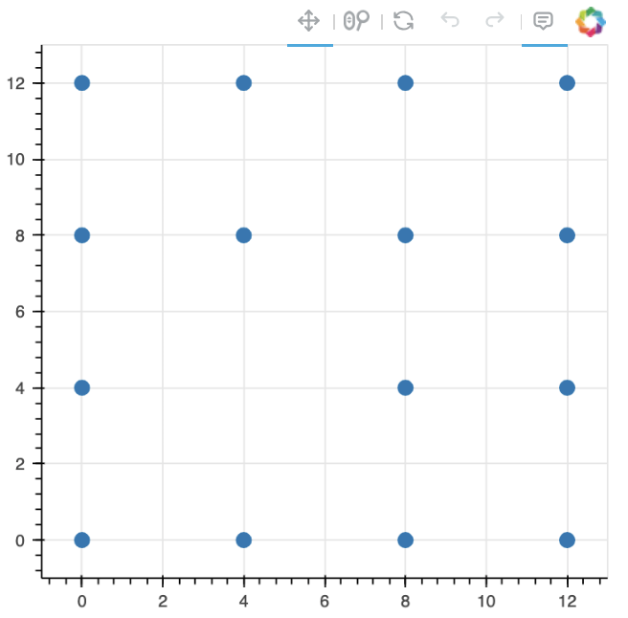
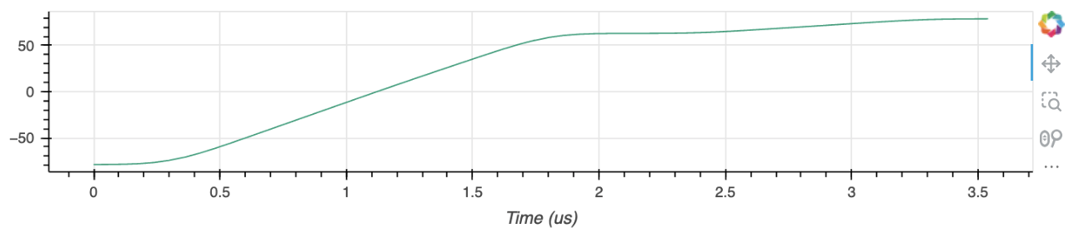
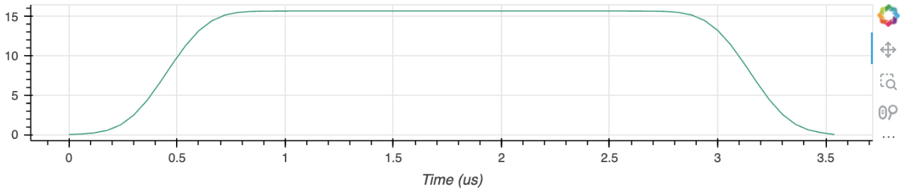
Solving a 4x4 Lattice on Aquila - Setup

Slide 20
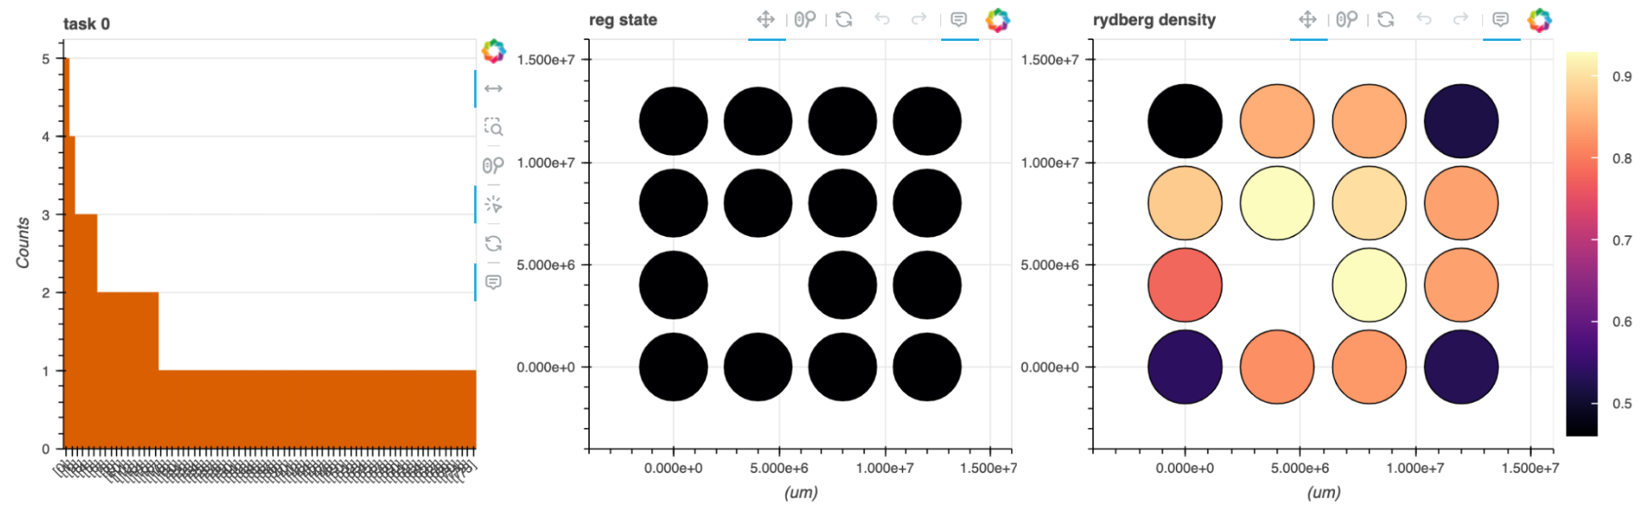
Solving a 4x4 Lattice on Aquila - Results
0 1 1 0
1 1 1 1
1 1 1 1
0 1 1 0
Highest Probability State (5%):
Rydberg Density Sum: 3.5

Slide 21
Plan For Larger Grids (when Aquila is back)
Use parameters (Ω and Δ) from classical optimization (Since we couldn’t use variational algorithm on Aquila)
Choose problem hardness based on classical annealing simulation.
Run on Aquila
(Optional) Postprocessing of Aquila solution using greedy algorithm

Slide 22
Business Applications

Slide 23
Business Applications: Selecting Features in ML model
Each feature in a dataset can be thought of as a vertex in a graph.
An edge between two vertices (features) could represent a redundancy or a strong correlation between those features.
The objective of finding an MIS in this graph would be akin to selecting a subset of features that are as independent from each other as possible (i.e., not connected by edges).
This "independence" minimizes redundancy and might help in building more generalized models.
Notes:
In the context of feature selection, each feature in a dataset can be thought of as a vertex in a graph. An edge between two vertices (features) could represent a redundancy or a strong correlation between those features. The objective of finding an MIS in this graph would be akin to selecting a subset of features that are as independent from each other as possible (i.e., not connected by edges). This "independence" minimizes redundancy and might help in building more generalized models.

Slide 24

Selecting Features in ML

Slide 25
VLSI
In VLSI design, floorplanning is the task of arranging large-scale components on a chip.
The goal is to optimize the layout for various objectives such as minimizing the total area of the chip, reducing the length of interconnects (which impacts the speed and power consumption), and avoiding thermal hotspots.
The MIS problem can be applied to model component placement where each vertex in a graph represents a component, and edges represent constraints such as incompatibility or interference between components.
An independent set in this graph could represent a set of components that can be placed together without violating these constraints, aiding in the identification of optimal placement strategies.

Slide 26
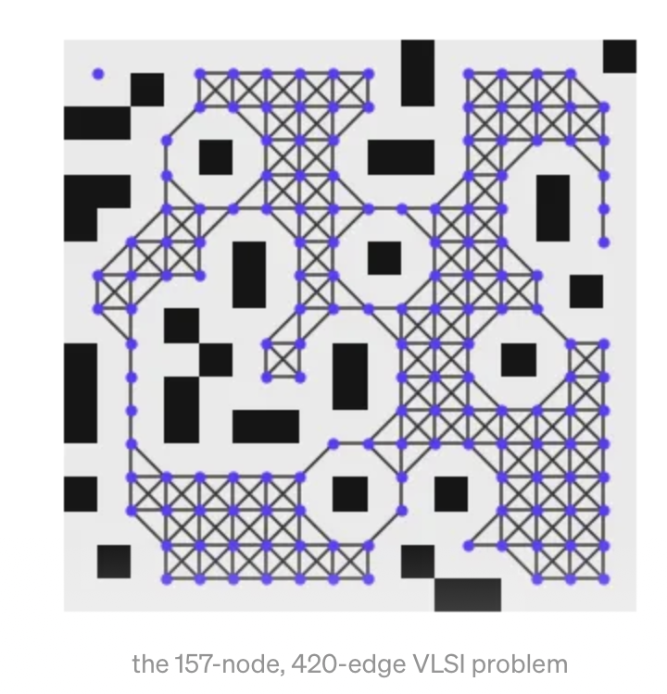
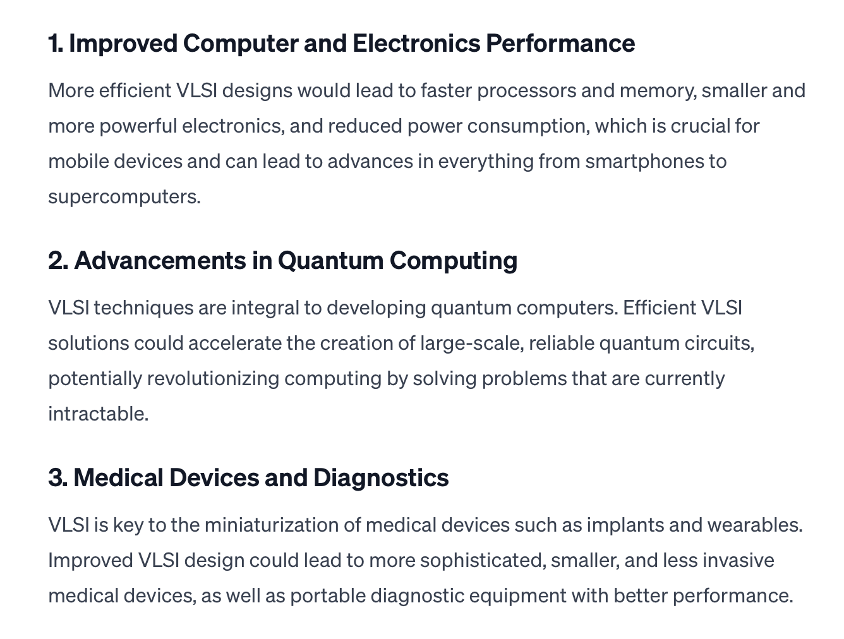
VLSI
Notes:
In VLSI design, floorplanning is the task of arranging large-scale components on a chip.
The goal is to optimize the layout for various objectives such as minimizing the total area of the chip, reducing the length of interconnects (which impacts the speed and power consumption), and avoiding thermal hotspots.
The MIS problem can be applied to model component placement where each vertex in a graph represents a component, and edges represent constraints such as incompatibility or interference between components.
An independent set in this graph could represent a set of components that can be placed together without violating these constraints, aiding in the identification of optimal placement strategies.

Slide 27
Sources
Github Assets and References
https://queracomputing.github.io/Bloqade.jl/dev/tutorials/5.MIS/main/
Edabi, A., et al. (2022). Quantum Optimization of Maximum Independent Set using Rydberg Atom Arrays. arXiv, arXiv:2202.09372.
Andrist, N., et al. (2023). Hardness of the Maximum Independent Set Problem on Unit-Disk Graphs and Prospects for Quantum Speedups. arXiv, arXiv:2307.09442.
Menssen, A. et al. (2023). Scalable photonic integrated circuits for high-fidelity light control. Optica, 10(10), 1366. https://doi.org/

Slide 28
Thanks for Listening!

